Slide 1
CRI3I3 Pemrograman Perangkat Bergerak
Navigation & Notification

Slide 2
Navigation & Notification
Package
Navigation
Notification

Slide 3
Package
Flutter supports using shared packages contributed by other developers to the Flutter and Dart ecosystems. This allows quickly building an app without having to develop everything from scratch.

Slide 4
Using Package
Find Packages at pub.dev
Open pubspec.yml, add under “dependencies”
Install it
Run Flutter pub get, or
From android studio, when open pubspec click “Pub Get”
From VS Code: Click Get Packages located in right side of the action ribbon at the top of pubspec.yaml.
Import it
Stop and Restart, if necessary

Slide 5
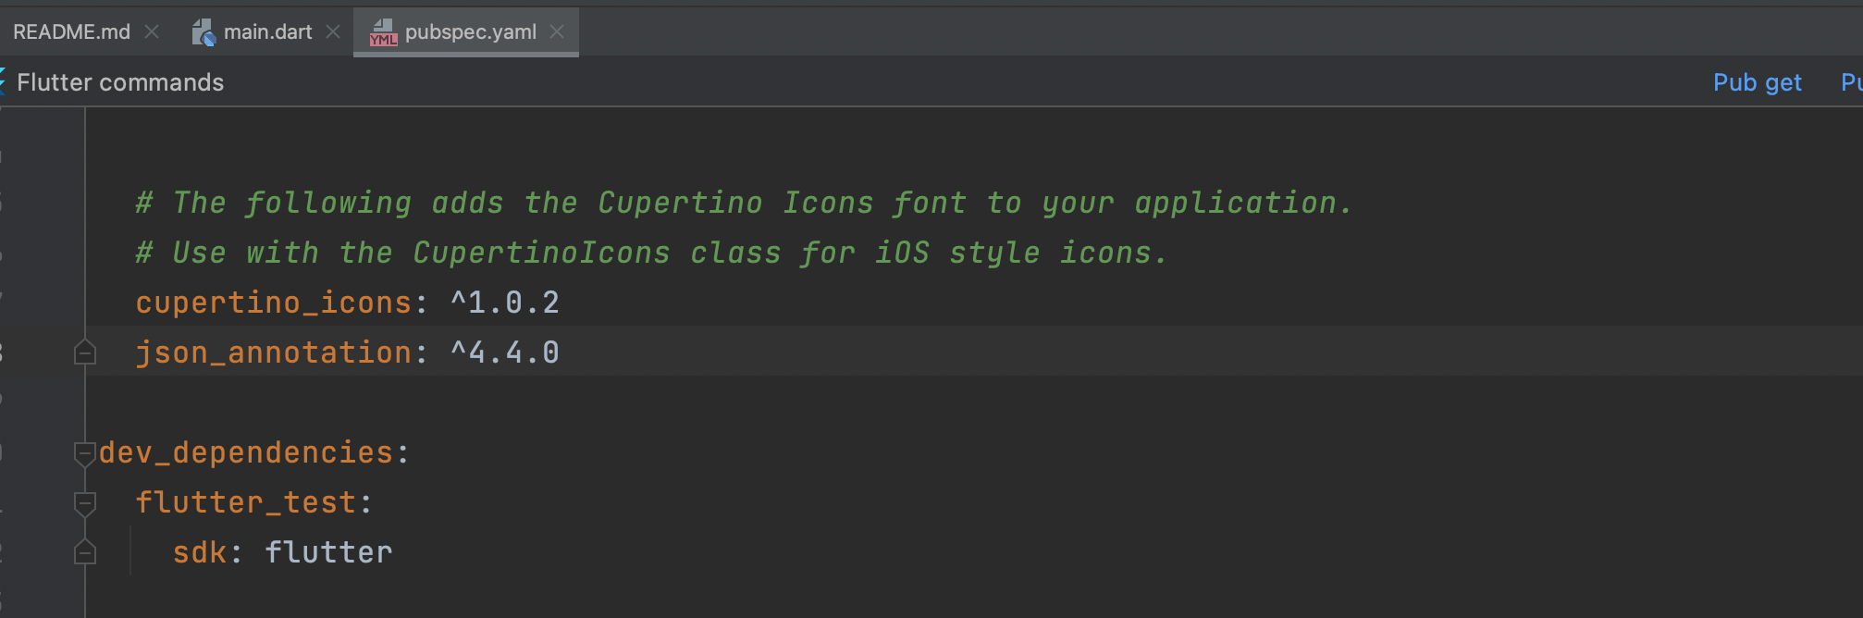
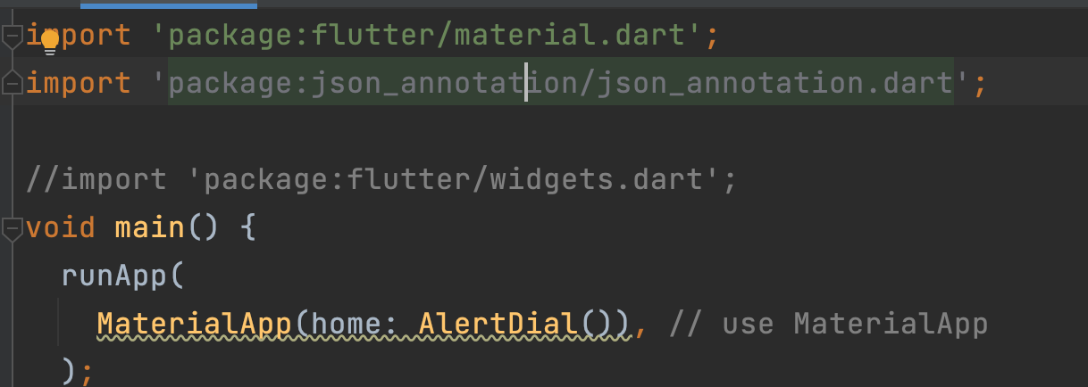
Example

Slide 6
Navigation
Navigate to new screen and go back
Navigate with named routes
Pass arguments
Return data and send data to new screen

Slide 7
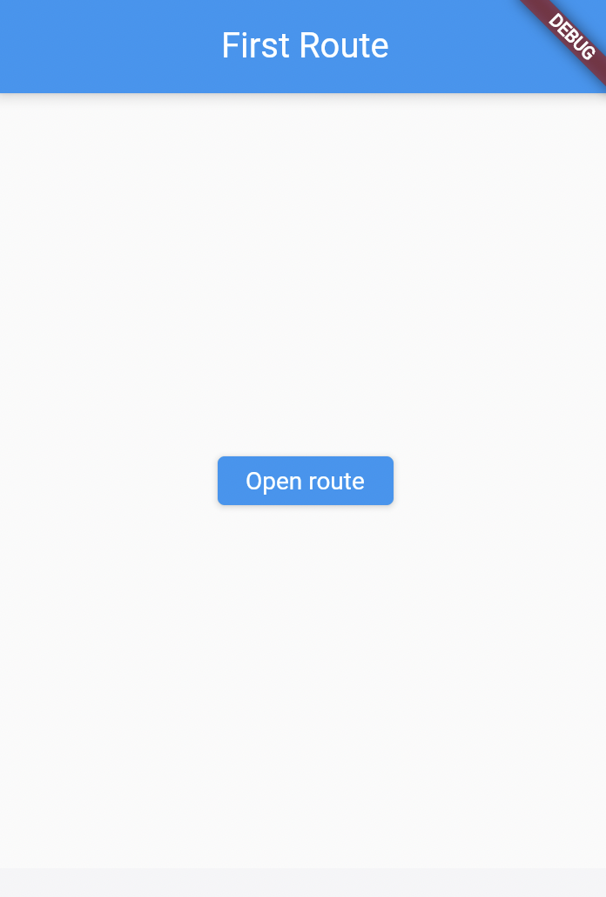
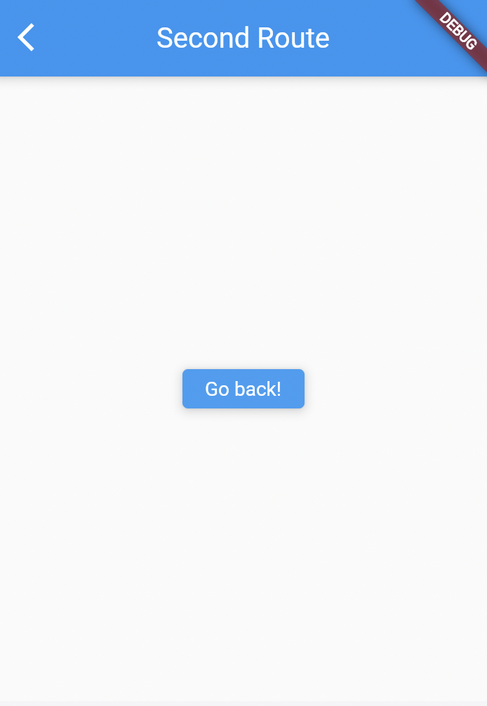
Navigate to new screen and go back
import 'package:flutter/material.dart';
void main() {
runApp(const MaterialApp(
title: 'Navigation Basics',
home: FirstRoute(),
));
}

Slide 8
Code Example
class FirstRoute extends StatelessWidget {
const FirstRoute({Key? key}) : super(key: key);
@override
Widget build(BuildContext context) {
return Scaffold(
appBar: AppBar(
title: const Text('First Route'),
),
body: Center(
child: ElevatedButton(
child: const Text('Open route'),
onPressed: () {
Navigator.push(
context,
MaterialPageRoute(builder: (context) => const SecondRoute()),
);
},
),
),
);
}
}
class SecondRoute extends StatelessWidget {
const SecondRoute({Key? key}) : super(key: key);
@override
Widget build(BuildContext context) {
return Scaffold(
appBar: AppBar(
title: const Text('Second Route'),
),
body: Center(
child: ElevatedButton(
onPressed: () {
Navigator.pop(context);
},
child: const Text('Go back!'),
),
),
);
}
}

Slide 9
Navigate with named routes
import 'package:flutter/material.dart';
void main() {
runApp(
MaterialApp(
title: 'Named Routes Demo',
// Start the app with the "/" named route. In this case, the app starts
// on the FirstScreen widget.
initialRoute: '/',
routes: {
// When navigating to the "/" route, build the FirstScreen widget.
'/': (context) => const FirstScreen(),
// When navigating to the "/second" route, build the SecondScreen widget.
'/second': (context) => const SecondScreen(),
},
),
);
}

Slide 10
Code Example
class FirstScreen extends StatelessWidget {
const FirstScreen({Key? key}) : super(key: key);
@override
Widget build(BuildContext context) {
return Scaffold(
appBar: AppBar(
title: const Text('First Screen'),
),
body: Center(
child: ElevatedButton(
// Within the `FirstScreen` widget
onPressed: () {
// Navigate to the second screen using a named route.
Navigator.pushNamed(context, '/second');
},
child: const Text('Launch screen'),
),
),
);
}
class SecondScreen extends StatelessWidget {
const SecondScreen({Key? key}) : super(key: key);
@override
Widget build(BuildContext context) {
return Scaffold(
appBar: AppBar(
title: const Text('Second Screen'),
),
body: Center(
child: ElevatedButton(
// Within the SecondScreen widget
onPressed: () {
// Navigate back to the first screen by popping the current route
// off the stack.
Navigator.pop(context);
},
child: const Text('Go back!'),
),
),
);
}
}

Slide 11
Another examples
Pass arguments : https://docs.flutter.dev/cookbook/navigation/navigate-with-arguments
Return data and send data to new screen : https://docs.flutter.dev/cookbook/navigation/passing-data

Slide 12
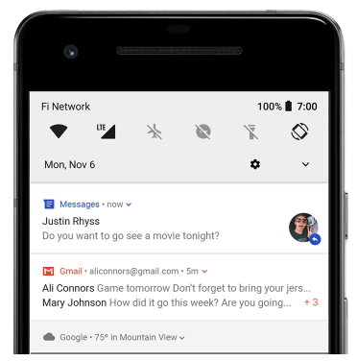
Notification

Slide 13
Local Notification VS Push Notification
The major difference between local and push notifications is that local notifications are scheduled by an app locally and are delivered by the same device, whereas push notifications are sent from a remote server.

Slide 14
How To
See:
Practicum Book ☺
https://pub.dev/packages/awesome_notifications
https://pub.dev/packages/flutter_local_notifications

Slide 15

Any question?

